Slide 1

Our Vision
The Oakville Community Association wants to contribute to creating an engaged, safe, caring, and vibrant community where all residents enjoy a positive quality of life

Slide 2
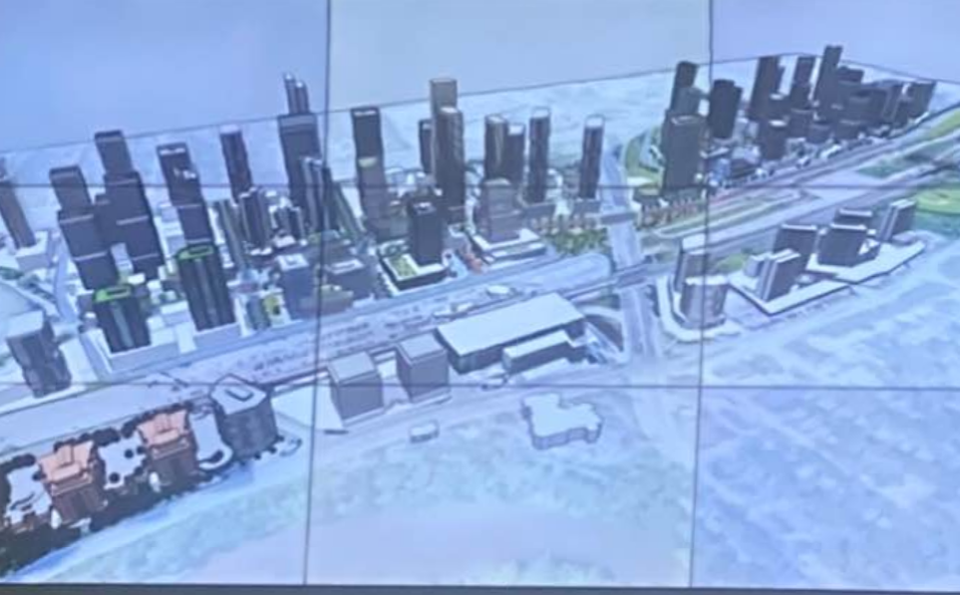

MIDTOWN PROPOSAL
Against our Vision

Slide 3
DENSITY OF RESIDENTS PER HECTARE-
MIDTOWN COMPARED TO MANHATTAN
Midtown
200 ppl/ha minimum target by 2031
400 ppl/ha target by 2051
1165 ppl/ha based on current proposals extrapolated over the total 103 hectares
Manhattan
280 ppl/ha
More than Manhattan? Why?

Slide 4
TRANSPORTATION AND INFRASTRUCTURE
The Transportation Report dated June 2014 marked as Final Report clearly sets out in section H on pages xi and xii the road design proposed for Midtown.
There is no mention of the immense cost of the infrastructure and how it would be financed in conjunction with the province.
A failure to complete the majority of the infrastructure improvements at an early stage would cause serious traffic congestion in the short and medium term of the development
Trafalgar Road and QEW Traffic is already heavy

Slide 5
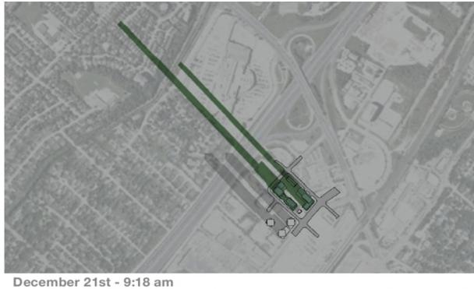
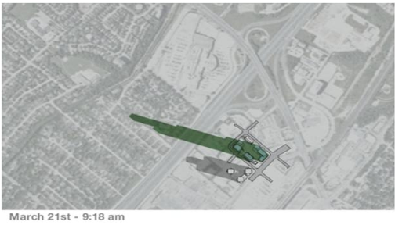
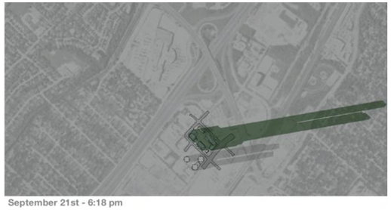
SHADOWS
A review of the Shadow Impact Study dated April 25, 2022, of one of the towers proposed at or near the corner of Cross Avenue and Argus Road depicts a significant impact on the surrounding areas as reflected in the examples.

Slide 6
FLOODPLAIN/SPILL ZONE
In 2020 Conservation Halton completed the mapping of the spill from the Morrison- Wedgewood Diversion Channel and confirmed that the Diversion Channel will now spill in the event of a major storm and the spill zone has only been mapped to the QEW as per the Conservation Halton ARL inserted below.
The spill mapping should be completed to determine the risk of flooding in event of a large storm within the Midtown proposed development area, which could be consistent with Section 2.5 of the MNRF 2002 Technical Guide River & Stream Systems: Flooding Hazard Limit. Section 2.5 confirms that,
  “Municipalities and planning boards should show or describe flood plain lands in their official plans and incorporate policies to address new development consistent with the policy statement.”

Slide 7
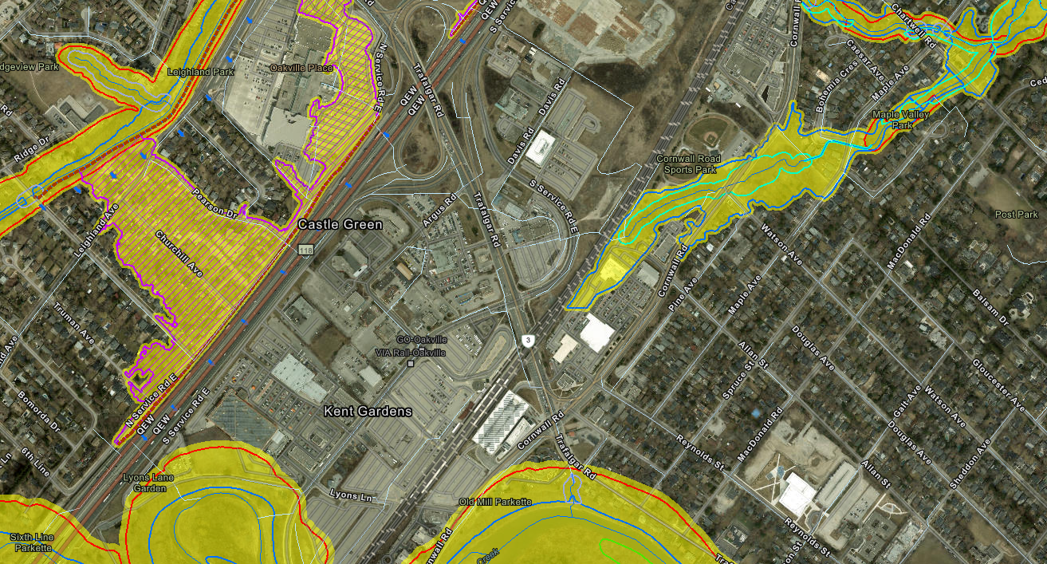
SPILL ZONE – BLUE ARRROWS

Slide 8
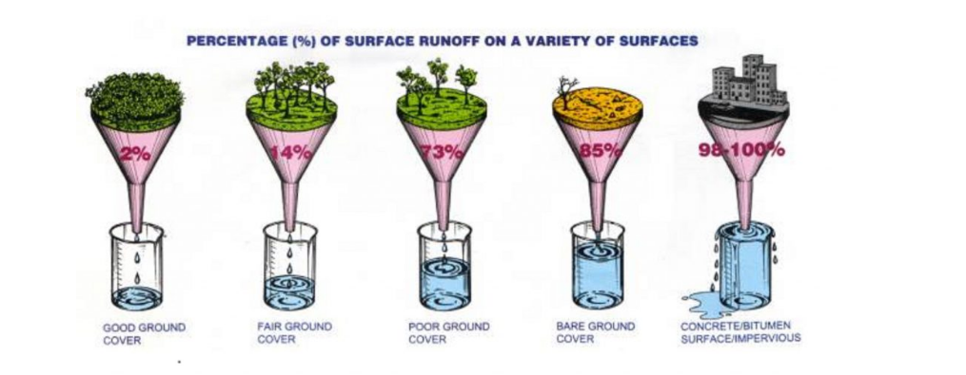
MORE RUNOFF WITH INCREASE IN IMPERVIOUS SURFACES

Slide 9
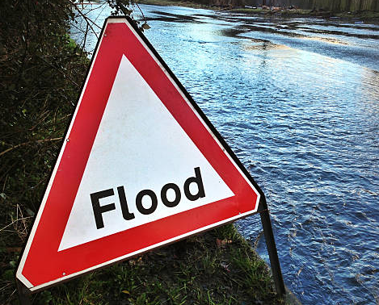
PROVINCIAL POLICY STATEMENT 2020 (PPS)
Section 1.6.6.7 of the PPS includes polices for stormwater management planning, including that it shall mitigate risks to human health and safety, property and the environment
Midtown will increase the risks for residents downstream

Slide 10

COMMENTS FROM OCA MEMBERS
Gross. Are we trying to look like Mississauga
So sad what is becoming of Oakville
Cross Avenue will become at 8 lane expressway to handle the traffic
Ugly as sin. Whoever came up with this ridiculous idea should be fired.
Disgusting
Horrible
Totally out of control…high rises like we have never seen before in Oakville.
The municipality clearly wants to completely destroy all that is beautiful about Oakville!

Slide 11
SUMMARY
Residents are not happy with the proposal at Midtown
Density could be higher than Manhattan and some cities in China and it is not needed to meet the Provincial targets
Increase of impervious surfaces will cause increased risks for residents
Shadows from highrise buildings will cast shadows over existing neighbourhoods
Morrison-Wedgewood Diversion Channel will spill in a major storm and the spill arrows currently stop on the QEW – mapping must be done
Official Plan should adhere to the MNRF 2002 Technical Guide River & Stream Systems: Flooding Hazard Limit by including the floodlines in the Plan
Section 1.6.6.7 of the PPS should be followed and mitigate mitigate risks to human health

Slide 12
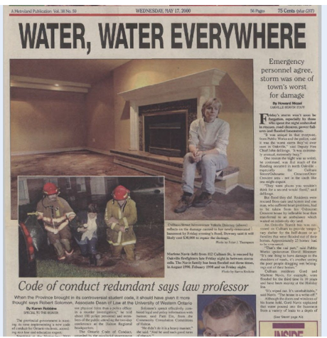
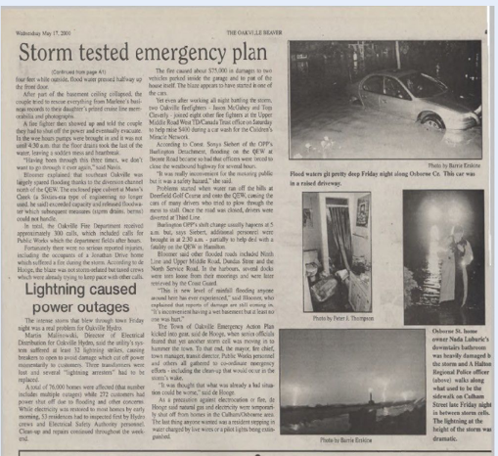
REMINDER
Articles of the 2000 Flood in Oakville

Slide 13
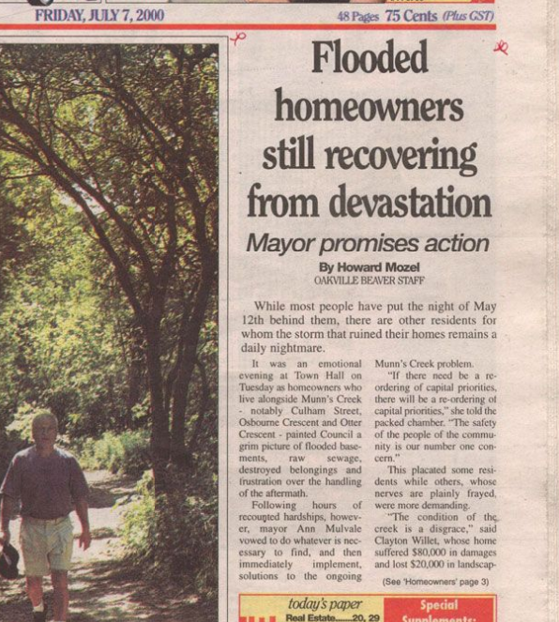
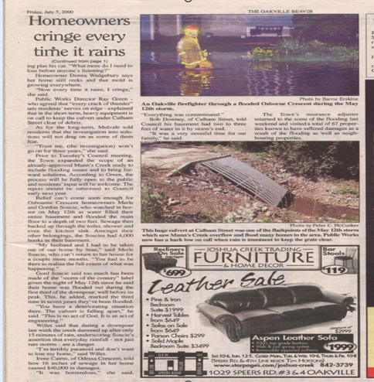
REMINDER
Articles of the 2000 Flood in Oakville

Slide 14
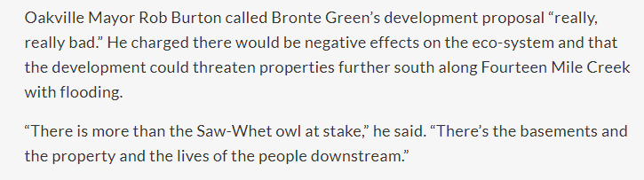
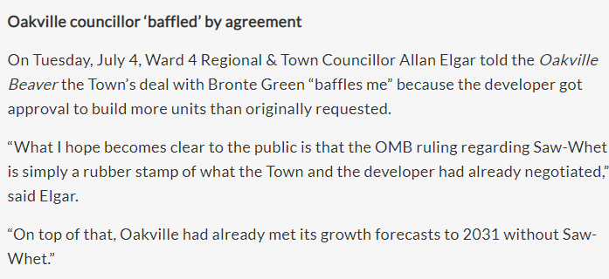
WE NEED TO LEARN
Saw-whet Development
InsideHalton reported on April 16, 2015
Oakville Beaver reported on July 4, 2017
We need to learn from Saw-whet
and not let history repeat with Midtown.

Slide 15
OCA CAN NOT SUPPORT MIDTOWN because
It will not create a safe, caring, and vibrant community where all residents enjoy a positive quality of life for all Oakville residents
The proposal does not fit within the character of Oakville
It will create a situation of potential increased risk to property damage and threat to life due to increased flood risks

Slide 16
THANK YOU FOR LISTENING
Sincerely,
OCA Board of Directors and our Members

