Slide 1

Our Vision
The Oakville Community Association wants to contribute to creating an engaged, safe, caring, and vibrant community where all residents enjoy a positive quality of life

Slide 2
Pubic Hearing Item 6.2 at September 11, 2023 Planning and Development Council Meeting
590 Argus Developments
Application for permit to increase building height from 20 storeys to 44, 50 and 58 storeys

Slide 3
FLOODPLAIN/SPILL ZONE
In 2020 Conservation Halton completed the mapping of the spill from the Morrison- Wedgewood Diversion Channel and confirmed that the Diversion Channel will now spill in the event of a major storm and the spill zone has only been mapped to the QEW as per the Conservation Halton ARL.
The spill mapping should be completed to determine the risk of flooding in event of a large storm within the area of this proposed development, which could be consistent with Section 2.5 of the MNRF 2002 Technical Guide River & Stream Systems: Flooding Hazard Limit. Section 2.5 confirms that:
“Municipalities and planning boards should show or describe flood plain lands in their official plans and incorporate policies to address new development consistent with the policy statement.”

Slide 4
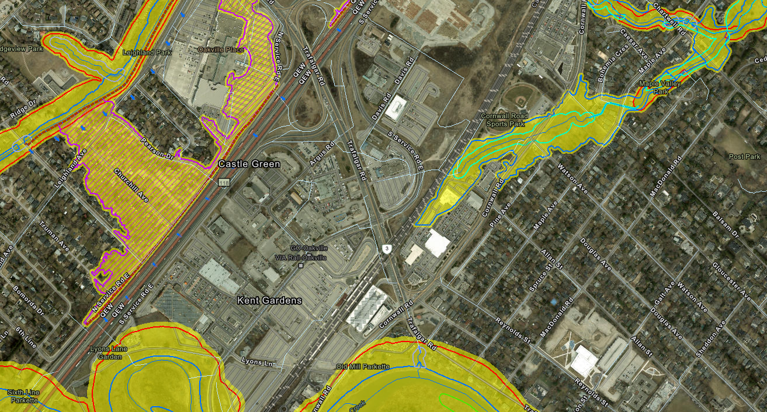
SPILL ZONE – BLUE ARRROWS

Slide 5
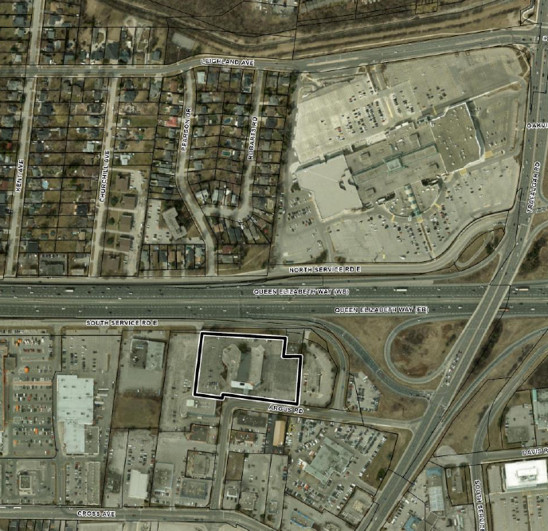
DEVELOPMENT SITE – RIGHT IN LINE WITH THE SPILLS

Slide 6
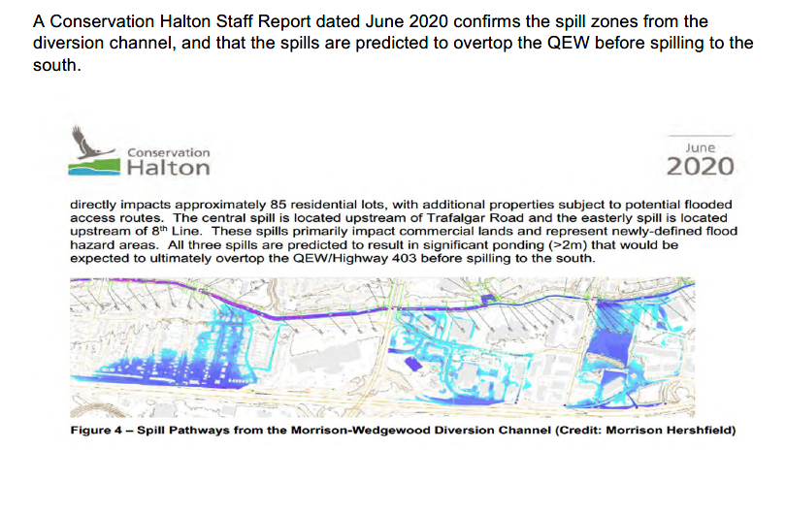
CAPITAL WORKS NEEDED ON THE MORRISON-WEDGEWOOD DIVERSION CHANNEL TO MITIGATE FLOOD IMPACTS AT MIDTOWN AND SOUTH OF MIDTOWN

Slide 7
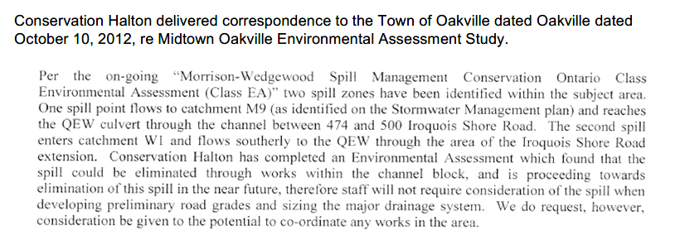
Oakville knew as early as October 10, 2012

Slide 8
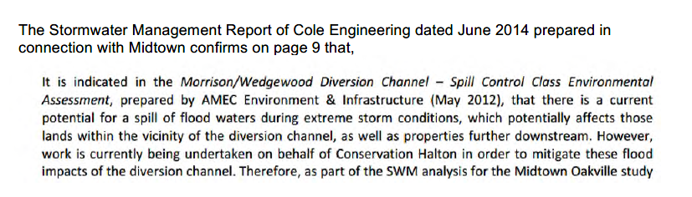
Conservation Halton knows about spill issues as early as May 2012 and says work being undertaken

Slide 9
Question:
Has Conservation Halton taken and steps to mitigate the spills from the Morrison-Wedgewood Diversion Channel?
Answer: To our knowledge no

Slide 10
OCA CAN NOT SUPPORT THIS DEVELOPMENT because
Updated mapping is required south of the QEW to confirm the spill impacts
The Morrison-Wedgewood Diversion Channel needs to be repaired and/or updated to eliminate the spills before any development should be approved at Midtown

Slide 11
THANK YOU FOR LISTENING
Sincerely, OCA Board of Directors and our Members

