Slide 1

Our Vision
The Oakville Community Association wants to contribute to creating an engaged, safe, caring, and vibrant community where all residents enjoy a positive quality of life

Slide 2
Pubic Hearing Item 6.1 at September 11, 2023 Planning and Development Council Meeting
PROPOSAL – 1020-1042 SIXTH LINE
57 dwelling units comprising of 55 townhouse units, semi -detached unit (2 dwellings) and the retention of the dwelling at 1042 Sixth Line

Slide 3
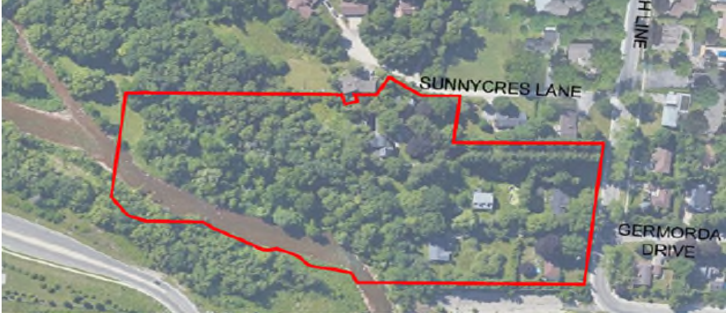
AERIAL VIEW OF THE AREA

Slide 4
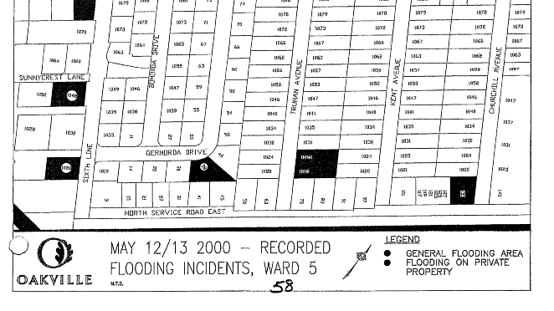
RISK OF FLOODING IN THE AREA
evidenced by flooding in May 2000

Slide 5
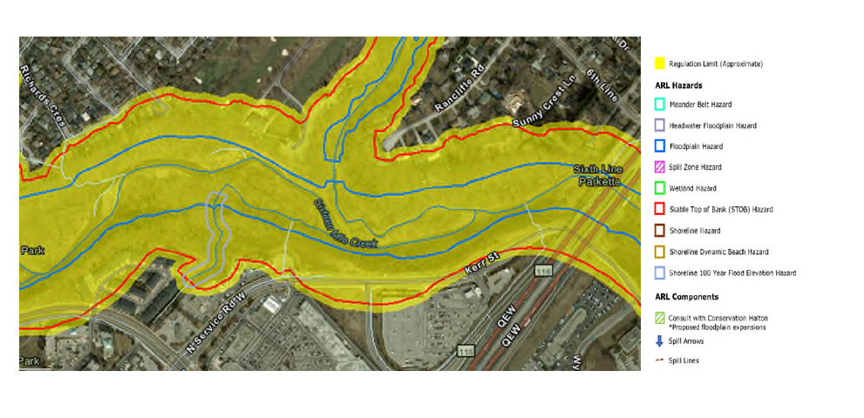
ARL OF CONSERVATION HALTON
Proposed area impacted by the Regulation Limit

Slide 6
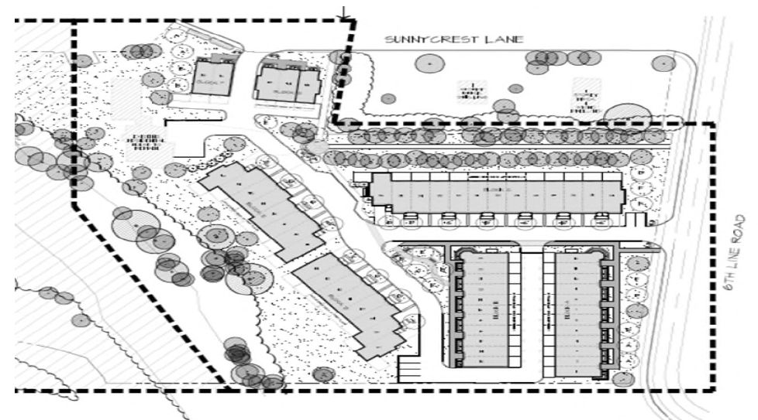
A DEPICTION OF THE PROPOSED DWELLINGS

Slide 7
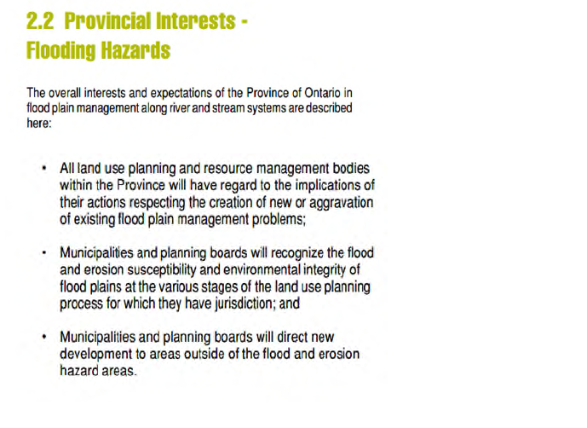
TECHNICAL GUIDE RIVER & STREAM SYSTEMS: FLOOD HAZARD LIMIT OF THE MINISTRY OF NATURAL RESOURCES DATED 2022

Slide 8
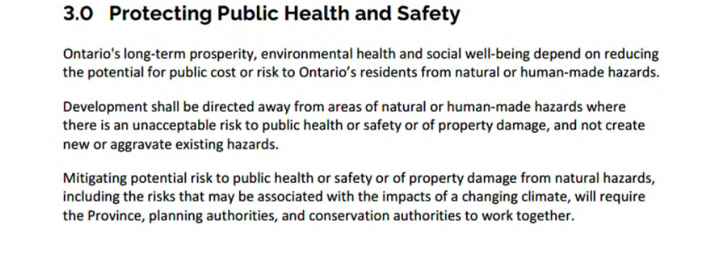
PROVINCIAL POLICY STATEMENT 2020 (PPS)

Slide 9
OCA CAN NOT SUPPORT THIS DEVELOPMENT
because
It will put people in harms way due to the risks of flooding that could result in increased risk of property damage and loss of life
The development of this site would be contrary to Provincial Policy as development would be within the Regulation Limit as indicated in the ARL map of Conservation Halton

Slide 10
THANK YOU FOR LISTENING
Sincerely,
OCA Board of Directors and our Members

