Slide 1

Our Vision
The Oakville Community Association wants to contribute to creating an engaged, safe, caring, and vibrant community where all residents enjoy a positive quality of life

Slide 2
SPECIAL COUNCIL MEETING - October 12, 2023
Agenda Item 3.1 – Response to the Housing Affordability Task Force’s Recommendations

Slide 3
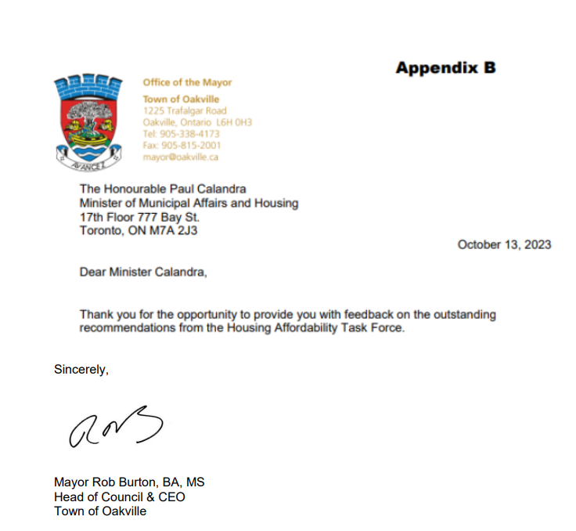
APPENDIX “B”

Slide 4
74 RECOMMENDATIONS
The most important thing the Ontario Government can do is utilize surplus provincial lands to build affordable housing and mixed or residential housing, now, while we continue to work as hard as we can to maximize supply. (Recommendation #70). The impact of increasing supply on prices for homebuyers will only be felt, in the long-term, when supply meets or exceeds demand.

Slide 5
RECOMMENDATION #70
#70 Review surplus lands and accelerate the sale and development through RFP of surplus government land and surrounding land by provincially pre-zoning for density, affordable housing, and mixed or residential use. The most important thing the Ontario government can do is utilize surplus provincial lands to build affordable housing and mixed or residential housing now, in the short term. (Recommendation #70). The impact of increasing supply on prices for homebuyers will only be felt, in the long-term, when supply meets or exceeds demand.
SELL GOVERNMENT LAND PURCHASER BUILDER AFFORDABLE HOMES

Slide 6
FEEDBACK
“I received feedback and recommendations from Oakville Town Staff, the Oakville Chamber of Commerce, We Love Oakville, the Trafalgar Chartwell Residents' Association, and Oakville Town Councillors. There was consensus on a majority of recommendations, and I incorporated their suggestions into my priority recommendations…”
WHY ONLY SELECT ORGANIZATIONS MENTIONED AND NOT MENTION SIGNIFICANT OTHERS WHO COMMENTED AND OFFERED INPUT THAT MAKES SOME SENSE?

Slide 7
RECOMMENDATIONS #7 AND #49
#7 (6) Permit “as of right” multi-tenant housing (renting rooms within a dwelling)
province-wide.
#49 (41) Funding for pilot projects that create innovative pathways to homeownership,
for Black, Indigenous, and marginalized people and first-generation
homeowners.

Slide 8
RECOMMENDATIONS #50 AND #58
#50 (42) Provide provincial and federal loan guarantees for purpose-built rental, affordable rental and affordable ownership projects.
#58 (50) Fund the adoption of consistent municipal e-permitting systems and encourage the federal government to match funding. Fund the development of a common data
architecture standard, supported by an external expert committee, across
municipalities and provincial agencies/ministries and require municipalities to provide
their zoning bylaws with open data standards. Set an implementation goal of 2025
and make funding conditional on established targets.

Slide 9
STAFF REVIEW
Our highly experienced and professional planning and finance staff reviewed the Housing Affordability Task Force report and determined that some recommendations “will either have no direct relation to housing affordability and attainable housing or will adversely affect the municipality.” (Report Attached) We Love Oakville, a non-partisan grassroots organization comprising residents association throughout Oakville, also studied the Task Force’s Report and will be sending your office their White Paper on the recommendations. The Town of Oakville is dedicated to contributing to the approval of housing applications, understanding that our role is in the approval process, not construction of housing units.

Slide 10
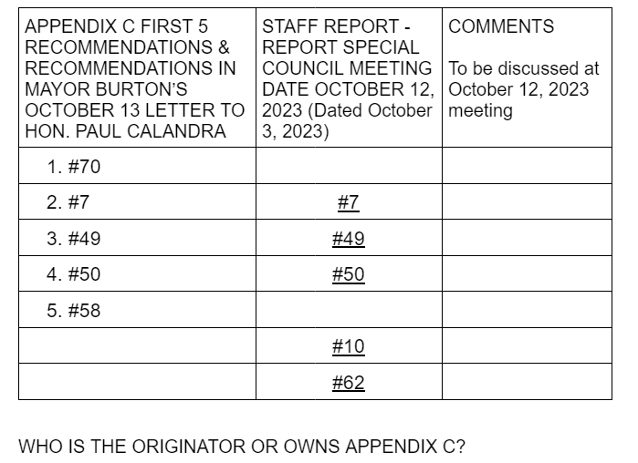
APPENDIX “C”

Slide 11
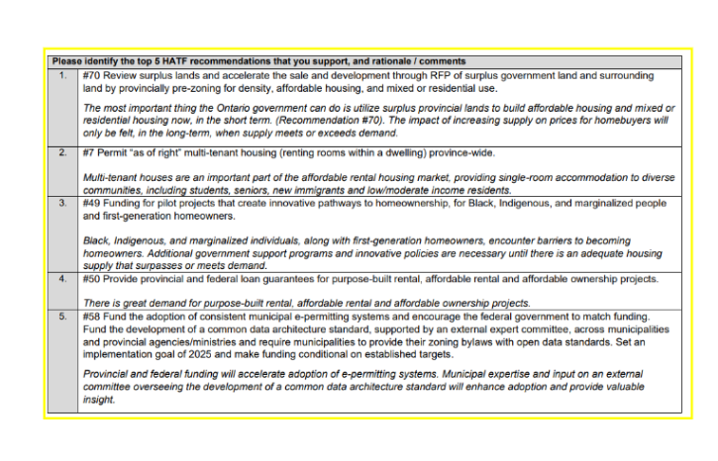
TABLE FROM
APPENDIX “C”

Slide 12
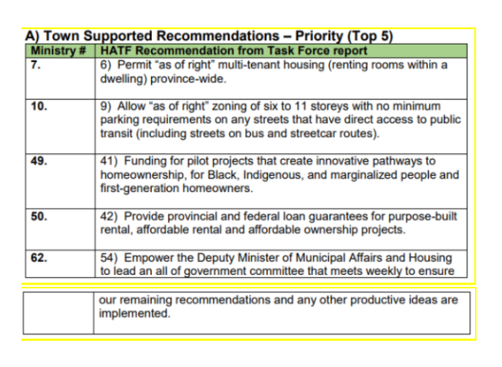
TOWN TOP 5

Slide 13
RECOMMENDATION #10
No problem with the zoning of 6 to 11 storey buildings on streets…BUT
No minimum parking requirements on any street that has direct access to public transit would create chaos for buses and motorists operating on those streets.

Slide 14
TOWN SUPPORTED RECOMMENDATIONS
OCA supports recommendations 8, 27,37,42
OCA does not support elimination of appeal process under recommendation 32 because who knows what an affordable development might constitute?

Slide 15
TOWN QUALIFIED SUPPORT FOR RECOMMENDATIONS
  OCA supports the Town’s qualified support for recommendations 4,18, 26, 30, 31, 38,
  40, 51, 56, 58, 59, 61.
Do not like the amendment of the Planning Act, PPS and the Growth Plan to address
housing growth needs. Parliamentary discussions are needed to revise the legislation.

Slide 16
TOWN DOES NOT SUPPORT
OCA supports the Town’s opposition to recommendations 9,11,12,15,16,17, 22, 28, 34, 36, 39, 43 and 57
OCA does not understand why the Town would not support recommendation 5 because conversion of underutilized or redundant commercial properties such makes great sense.

Slide 17
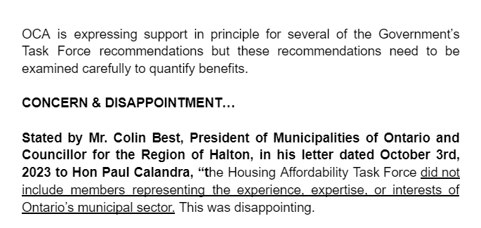
LETTER OF COLIN BEST DATED OCTOBER 3, 2023

Slide 18
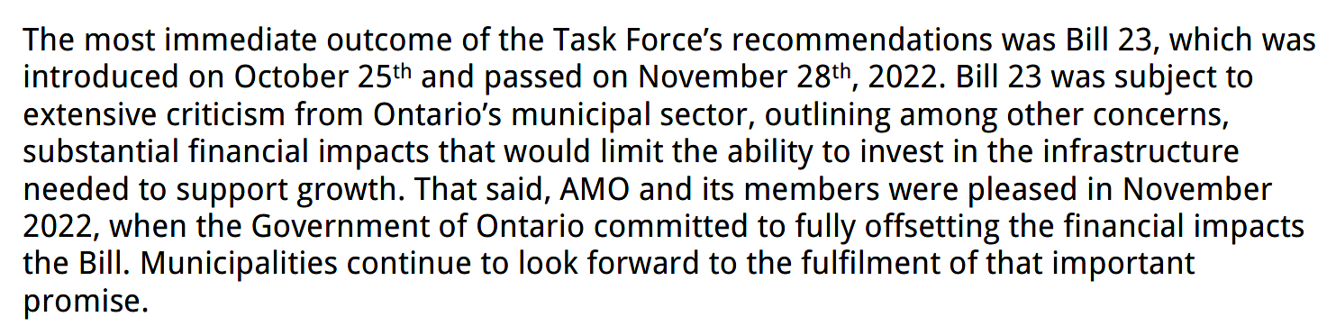
BILL 23, MORE HOMES BUILT FASTER ACT
Colin Best stated:
ccccc

Slide 19
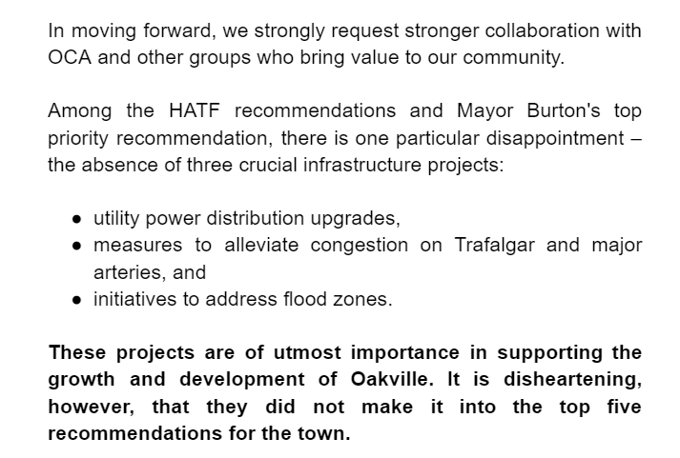
MOVING FORWARD

Slide 20
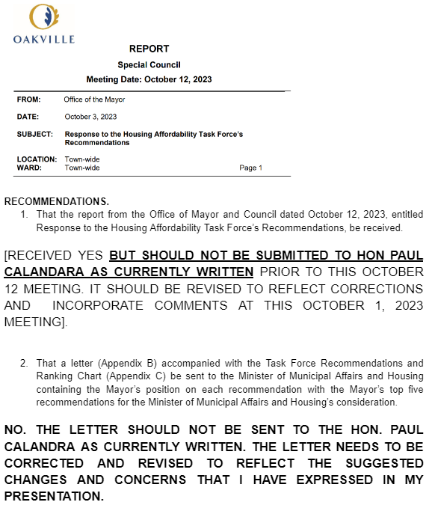
STAFF REPORT DATED
OCTOBER 3, 2023

Slide 21
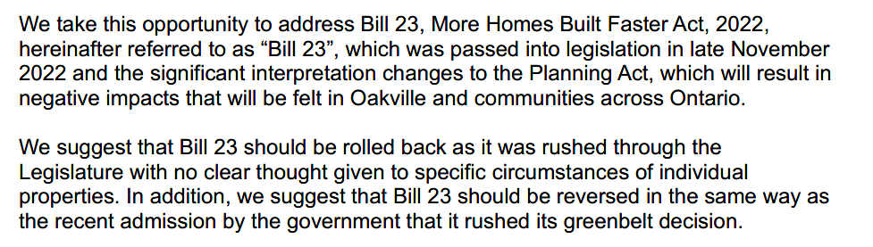
OCA LETTER TO PREMIER FORD dated September 22, 2023

Slide 22
THANK YOU FOR LISTENING
Sincerely,
OCA Board of Directors and our Members

