Slide 1

Our Vision
The Oakville Community Association wants to contribute to creating an engaged, safe, caring, and vibrant community where all residents enjoy a positive quality of life

Slide 2
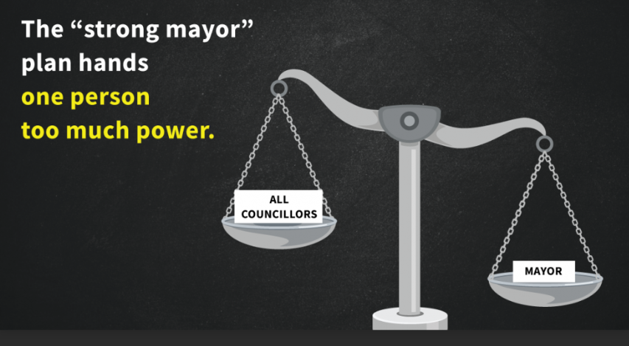
PLANNING AND DEVELOPMENT COUNCIL
APRIL 22, 2024
MIDTOWN PROPOSED OFFICAL PLAN AMENDMENT
IMPACT OF STRONG MAYOR
POWERS ON MIDTOWN OPA

Slide 3
MAYOR BURTON GRANTED STRONG MAYOR POWERS
EFFECTIVE JULY 1, 2023
The legislation gives the mayor veto powers over bylaws that conflict with provincial priorities such as building housing.
Strong mayor powers offer tools to help heads of council cut red tape and speed up the delivery of key shared municipal-provincial priorities such as housing, transit and infrastructure in their municipalities.

Slide 4
WHAT ARE STRONG MAYOR POWERS?
Strong mayor powers and duties include:
Choosing to appoint the municipality’s chief administrative officer
Hiring certain municipal department heads, and establishing and re-organizing departments
Creating committees of council, assigning their functions and appointing the chairs and vice-chairs of committees of council
Proposing the municipal budget, which would be subject to council amendments and a separate head of council veto and council override process
Vetoing certain by-laws if the head of council is of the opinion that all or part of the by-law could potentially interfere with a provincial priority
Bringing forward matters for council consideration if the head of council is of the opinion that considering the matter could potentially advance a provincial priority

Slide 5
WHAT CAN MAYOR BURTON DO WITH THESE POWERS?
Those powers allow him to veto majority council decisions that he thinks conflict with provincial priorities, such as increasing housing supply or building infrastructure unless 2/3 of town councillors vote against his veto.
RESULT: The majority of counsel which would be 8 members could vote against the Midtown Official Plan Amendment, but Mayor Burton could veto this, and that veto would stick unless 10 members (2/3) disagreed with the veto.

Slide 6
MOTION TO OPPOSE STRONG MAYOR POWERS
January 30, 2023
Council voted unanimously during its Monday, Jan. 30 meeting to officially oppose Bill 3, the Strong Mayors, Building Homes Act, 2022, and Bill 39, the Better Municipal Governance Act, 2022.
Council, including Burton, voted unanimously to oppose the province’s Strong Mayors legislation.
Burton made his thoughts clear on strong mayor powers back at a meeting on Jan. 30, 2023 when he joined Town Council in a unanimous vote on a motion to oppose the legislation that was then granted to the mayor of the cities of Toronto and Ottawa.

Slide 7
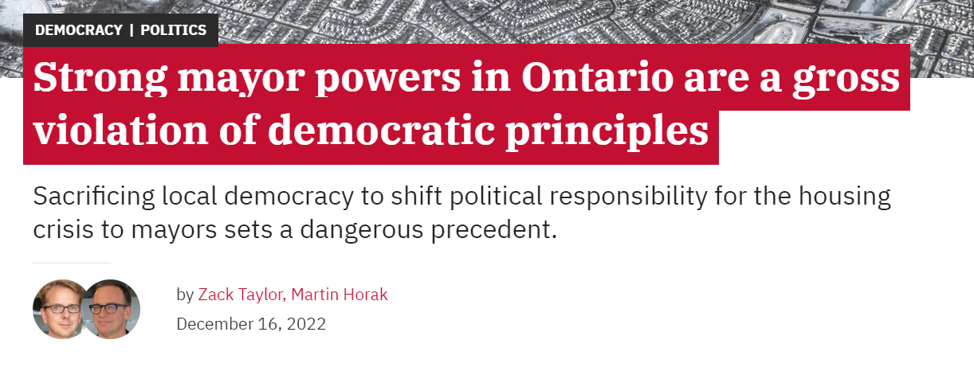
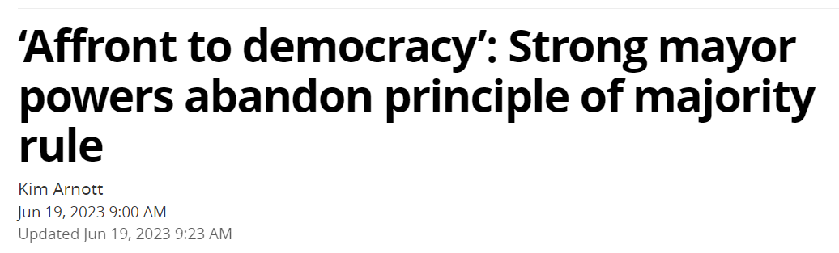
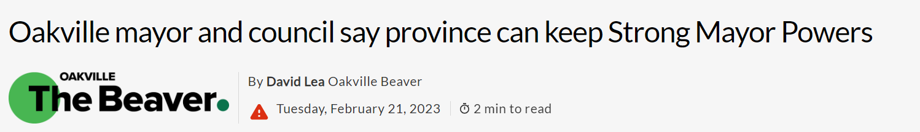
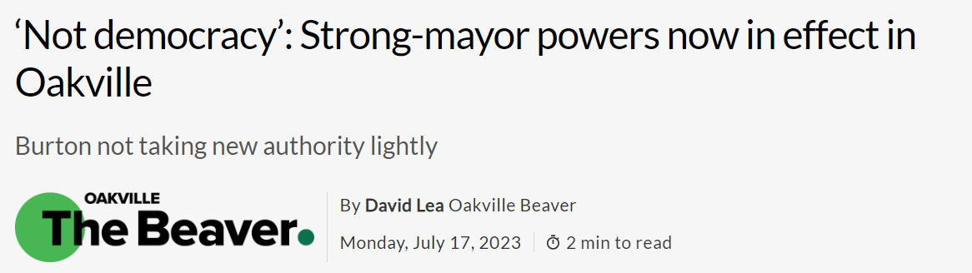
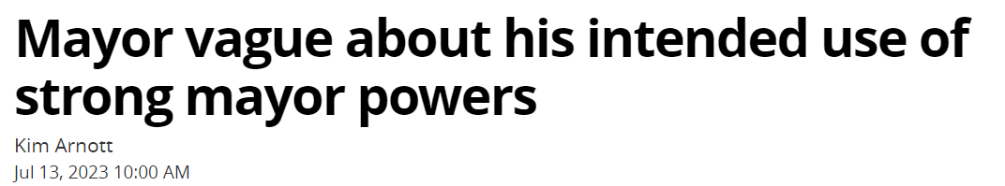
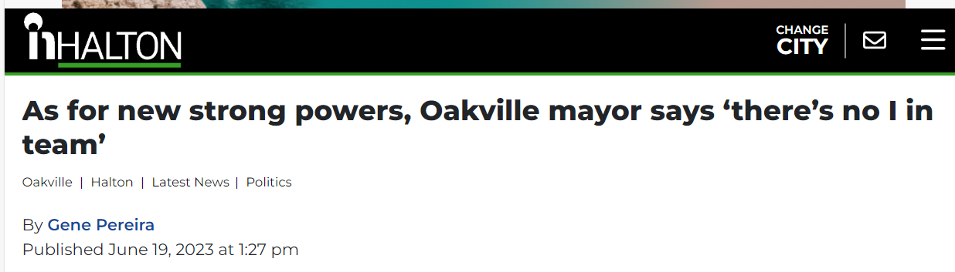
THE MEDIA REPORTS
OAKVILLENEWS.ORG
THE OAKVILLE BEAVER
INHALTON

Slide 8
QUOTES OF COUNCIL MEMBERS
Reported in the Media
"It doesn't lead to better democracies that way and never has through history.” – Councillor O’Meara
“Any time that five members of council can control the other ten members of council, we have a problem.” - Councillor Elgar
“It’s kind of like it’s not democracy anymore, a true democracy…It’s not one vote for every head. It’s weighted.” - Councillor Elgar
“Frankly, the mayor wasn't elected by the people of Oakville to have powers to veto us as elected representatives.” – Councillor Haslett-Theall
“The new powers are an affront to democracy that take away the rights of the community to have their representatives stand up for their values and expectations.” – Councillor Knoll
“The new rules would allow five of Oakville's 15 council members to decide on a budget or land use plan for the town.” – Councillor Haslett-Theall
“It’s great news our Council voted unanimously against this anti-democratic move…Our mayor was extremely vocal against it.” – Councillor O’Meara

Slide 9
COMMENTS OF MAYOR BURTON
“I will continue to serve as a mayor that wants to be known for collaboration and team work,” said Burton on Jan. 30. “There is simply no other way to accomplish anything for our residents. I am guided by an old proverb, ‘If you want to go fast, go alone. But if you want to go far, go together.’ I have striven that we go together.” – InHalton – July 10, 2023
“That’s why I continue to say I cannot imagine ever needing to use strong mayor voting and veto powers.” September 2023 State of the Town Address
“There is no ‘I’ in team and there’s no possible way we can enjoy the successions and accomplishments in Oakville and Halton that we have achieved without approaching our work as ‘Team Oakville,’” he said. “Our strong councils have done a lot for an officially weak council, weak mayor system.” InHalton – June 19, 2023

Slide 10
OCA ENCOURAGES:
To listen to the residents and Residents’ Association and discount the work done by the Consultants on the OPA as they did no listen to the residents or members of Council.
Let democracy work as it was intended.
Mayor Burton to not use his Strong Mayor Powers should the opportunity arise to receive or accept the proposed OPA, which would be consistent with the precedent set to date of not using these powers.
Do not allow one individual to decide the fate of Midtown and ultimately the fate of Oakville’s future.

Slide 11
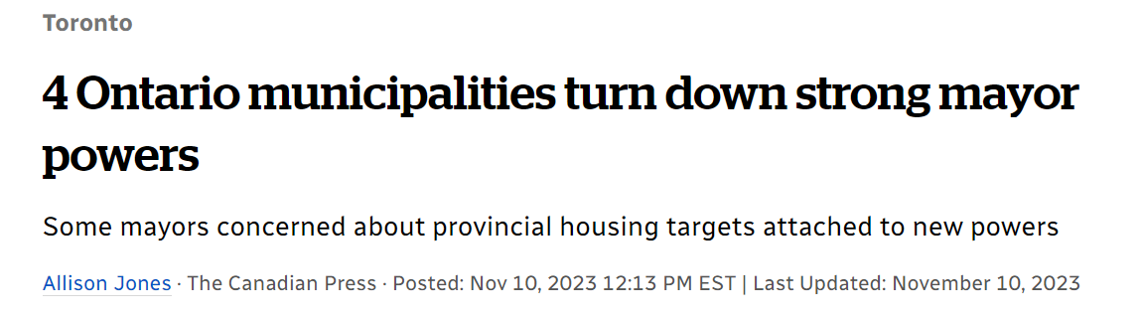
CONCLUSION
Strong Mayor Powers should not be used as it relates to Midtown and in fact Oakville should have officially turned down the powers like Newmarket, New Tecumseth, Norfolk County and Haldimand County did.

Slide 12
THANK YOU FOR LISTENING
Sincerely, OCA Board of Directors

